Slide 1

SAT Scores and Participation Rate
By Thomas Plapinger

Slide 2

Background
SAT – The Scholastic Aptitude Test
1.69 Million Test takers annually
~200,000 outside the US
Three Sections
Critical Reading, a.k.a. Verbal(20-800)
Mathematics(200-800)
Writing (0-24 Points)

Slide 3
Our Questions?
What percentage of SAT eligible students are taking the test in each state?
What are their Average Verbal and Mathematics scores?
Is there a correlation between participation and tests scores?

Slide 4
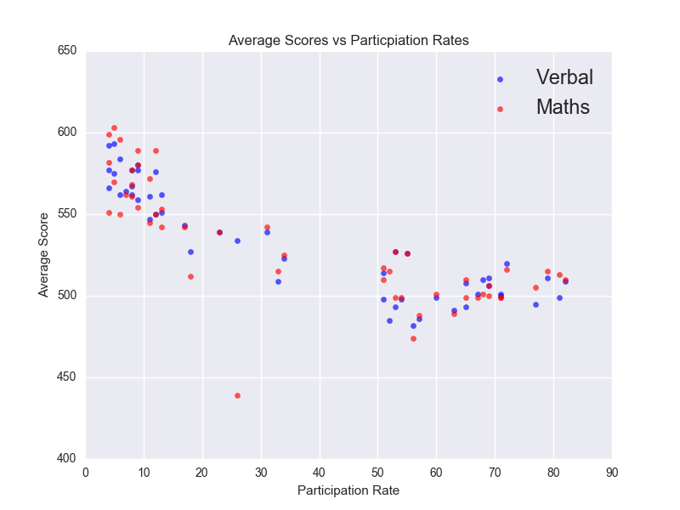
Data and What it is Saying
States with ≥51% participation
Math Scores Avg. 505
Verbal Scores Avg. 502
States with ≤34% Participation
Math Scores Avg. 539
Verbal Scores Avg. 560
Avg. Participation 37%
Avg. Verbal 532.5
Avg. Math 531.5
Notes:
Ohio is outlier of Math with a score of 439 for < 34% mark

Slide 5
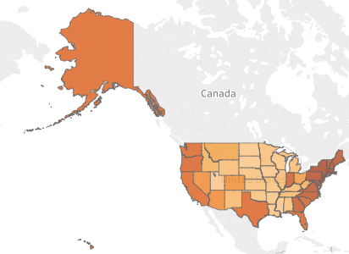
Differences in Min and Max
States with ≥51% participation
Math Scores 488-527
Verbal Scores 482-527
States with ≤34% Participation
Math Scores 439-603
Verbal Scores 488-593

Slide 6
Deduction
States with higher participation rate tend to have an average lower score and total score than lower participating states.

Slide 7


Data Gaps and Areas for Further Study
Writing Section
SAT vs ACT
PSAT Scores
PSAT to SAT
Universities Applied to by ACT and SAT test takers

Slide 8
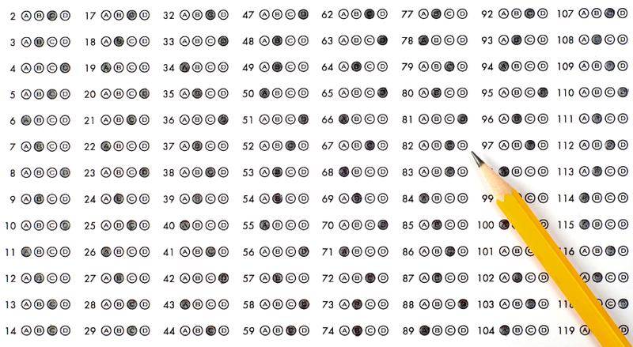
Any Questions?

